Slide 1
Higher Biology
Structure of the Genome
Mr G R Davidson

Slide 2
Structure of a Genome
The genome of an organism consists of the information in the DNA of its chromosomes.
There are genes which code for proteins.
However, there are also sequences of DNA which don’t code for proteins.
These can be lengths of DNA with repeating sequences and, as yet, we are still unsure of the role of some of these.
However, we do now know what some of them do.

Slide 3
Regulation of Transcription
RNA polymerase needs the help of transcription factors to start transcription.
Some of these are known as activators and are attached to non-coding sequences of DNA called regulators.
When the DNA bends, the activator is brought into contact with the other transcription factors.

Slide 4
Regulation of Transcription
The activator and other transcription factors now combine to form a molecular complex which triggers the start of transcription.
In this way transcription is regulated by a sequence of non-protein-coding DNA bases.

Slide 5
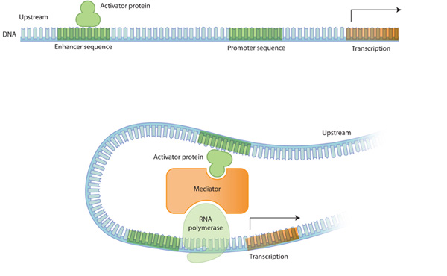
Regulation of Transcription

Slide 6
Transcription of non-translated RNA
There are base sequences in the DNA which code for mRNA, and this will be translated into a protein.
There are, however, sequences which code for different types of RNA which do not code for proteins such as:
tRNA – transfer RNA
rRNA - ribosomal RNA
RNA fragments
Notes:
tRNA is responsible for transporting the amino acids to the mRNA using anti codons to match the codons.
rRNA (ribosomal RNA) is combined with a protein to form a sub-unit in the nucleus. These sub-units are then exported to the cytoplasm where they are joined to make ribosomes.
RNA fragments help in the production of mRNA and are also responsible for stopping genes from transcribing.

Slide 7
Protection
Some of these non-protein-coding sequences form structures called telomeres.
These protect important base sequences by being at the end of the chromosome and stopping fraying.

